Slide 1


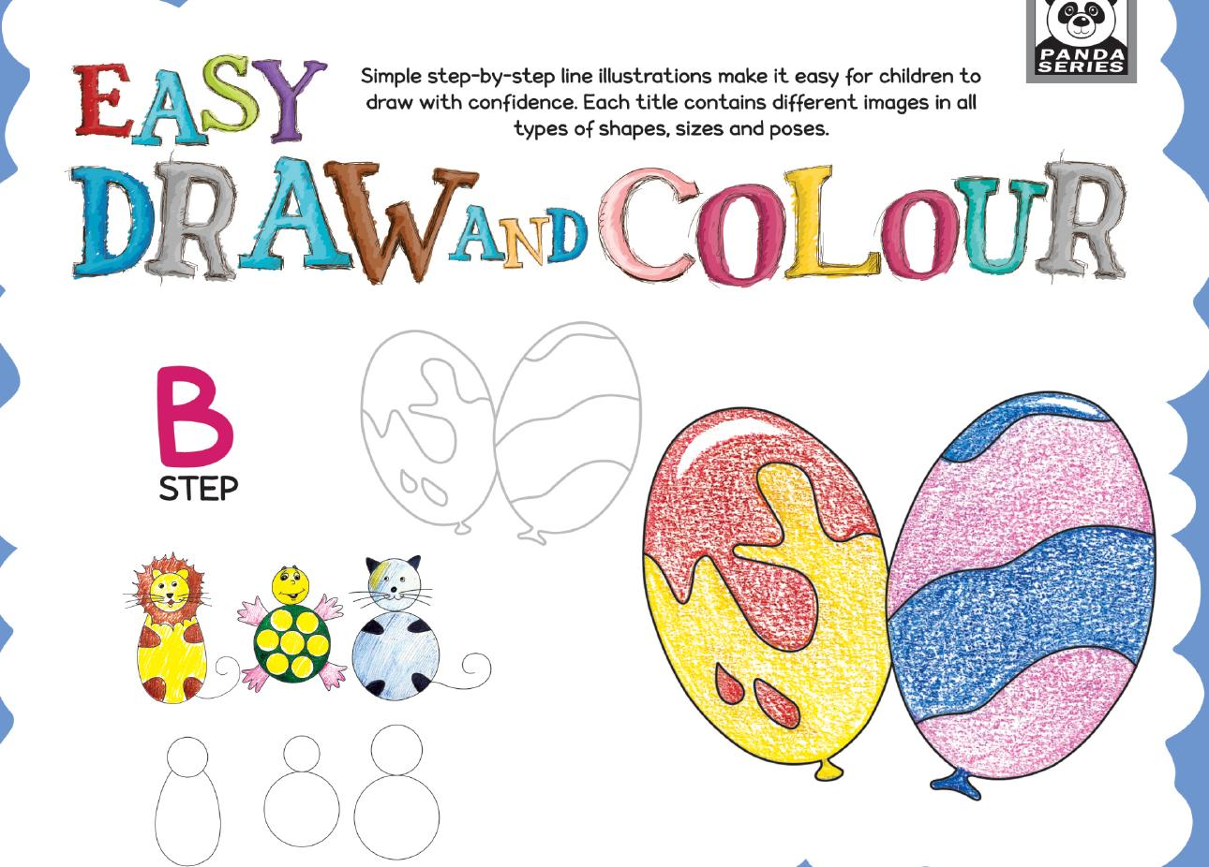
Easy Draw and Colour — Step B
Playgroup • Age 4+
An activity-based early-years book from the Panda Series.
A Project of Azhar Publishers & Book Factory

Slide 2
i
What's Inside
Easy Draw and Colour — Step B Playgroup • Age 4+
1
Building on Step A skills
2
More shapes and patterns
3
Step-by-step draw and colour
4
Tracing, dot-to-dot and grids
5
Match, paste and collage fun
6
Animals, objects and scenes

Slide 3
★
Purpose & Classroom Support
Develops drawing confidence and pencil control a step further, with simple step-by-step line illustrations.
“
Every book comes with
1
2
3
Teacher's Lesson Plan
Practice Papers
Digital Interactive Version
A 40-week lesson plan that guides teachers, day by day.
Monthly tests and term exam papers for children to attempt.
An interactive flipbook and digital exercises for engaging, screen-based practice.
A Project of Azhar Publishers & Book Factory

